Slide 1
MAR 580: Advanced Population Modeling for Management of Living Marine Resources
RTMB Session II
(Acknowledgements: Mollie Brooks, Kasper Kristensen, Arni Magnusson, Anders Nielsen, André Punt)
Fall 2025

Slide 2
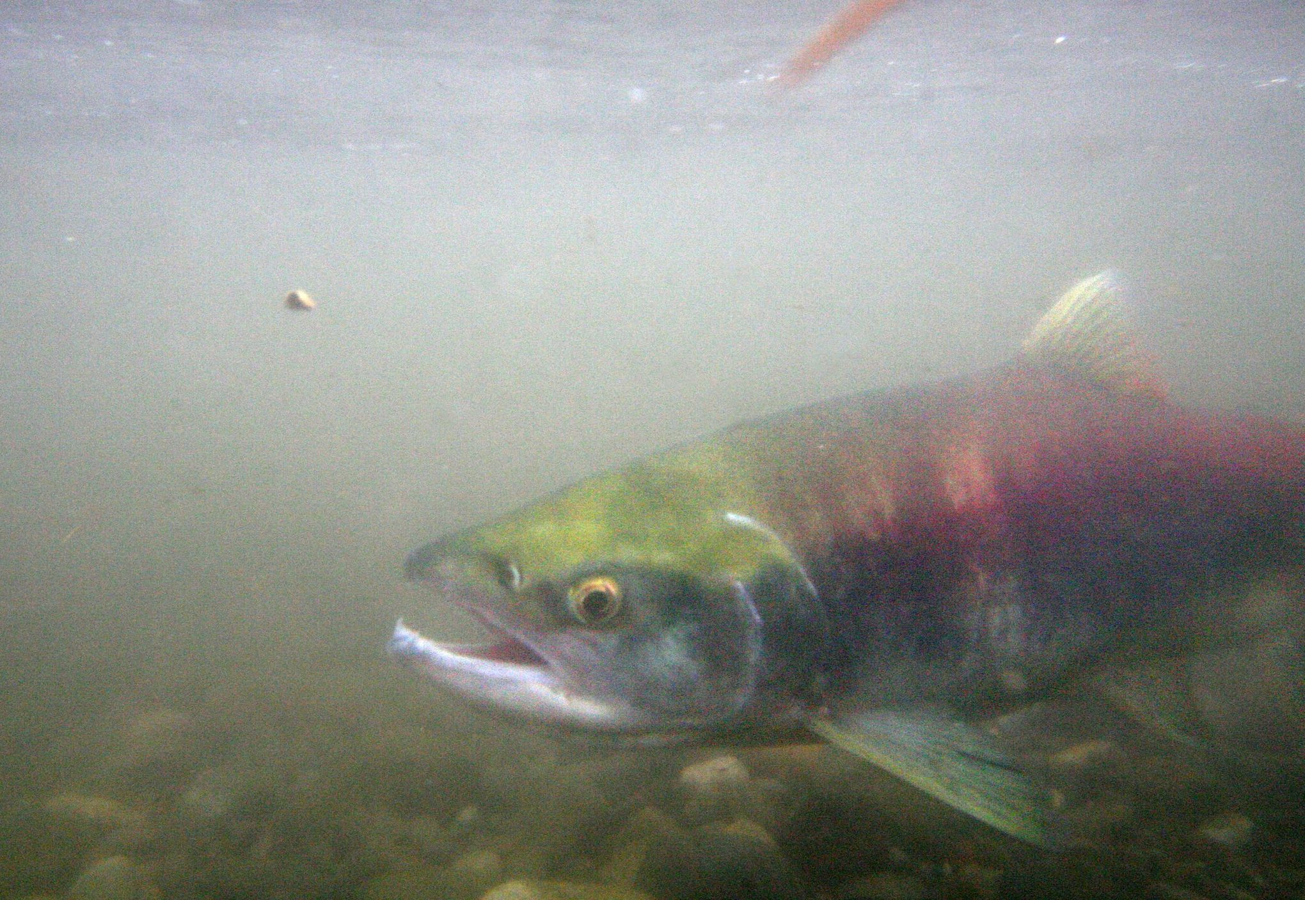

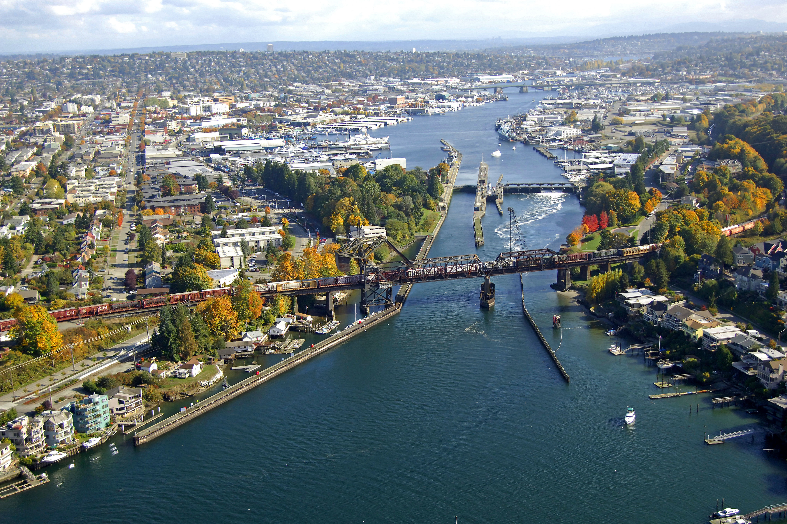
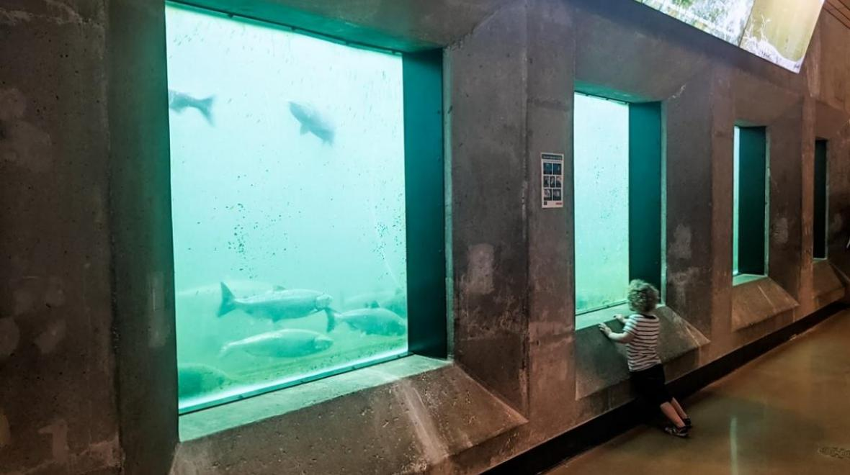
Example: Poisson GLM
Lake Washington sockeye
Salmon counts at the Ballard locks

Slide 3
Exercise: Poisson GLM with covariate
Plot the residuals of the salmon count model with respect to month
Extend the salmon count RTMB model to include a month effect
i.e. Fit the model:
Y(i) ~ Poisson(λ(i))
ln(λ(i)) = β_{month(i)}
Plot the resulting residuals
Compare the model with the month effect to the single-intercept model using AIC.

Slide 4
When should I use RTMB?
TLDR: when you need to.
Several packages leverage TMB for calculations but don’t require you to program the objective function (or learn C++).
{glmmTMB}
{sdmTMB}
{VAST}
Many common model types are already implemented in TMB and linked with R, & available online (e.g. assessment models in OpenMSE, packages like WHAM/SAM, etc.)
RTMB (or other custom model) might be needed for nonlinear latent variable dynamic models, and/or multiple observation models (multiple data types). (R)TMB very good for models with lots of random effects (e.g. spatial models)
If you can dream it (and write your objective function), (R)TMB can fit it?

Slide 5
TMBhelper package
Contains AICTMB() function.
devtools::install_github("kaskr/TMB_contrib_R/TMBhelper")
Additional TMB contributed R packages available at
https://github.com/kaskr/TMB_contrib_R
(includes TMBphase to do phased estimation a la ADMB, and TMBdebug)

Slide 6
Likelihood profile
We obtained estimates of variance yesterday by asymptotic methods
TMB can also do likelihood profiles
prof <- tmbprofile(model,”par_name”)
confint(prof, level = 0.95)

Slide 7
Simulating from the model
New datasets can be generated from the estimated model using obj$simulate()
Can use to do automatic internal consistency check (checks gradients
chk <- checkConsistency(obj)
Refit model to the new datasets:
chk <- checkConsistency(obj, estimate=TRUE)
summary(chk)
Generically simulate new datasets:
obj$simulate()

Slide 8
Linear modeling review LMs, GLMs, NLMs
LM and GLM are used to describe whether and how a response variable depends on a combination of predictors.
Predictors can be numeric (continuous) or factors (categorical).
Linear
Quite flexible as it is
Generalized
Any error distribution
Nonlinear
Any relationship between Y and X
closed form solution
iterative solution

Slide 9
What are Fixed and Random Effects?
Fixed Effects:
Parameters associated with the entire population or with certain repeatable levels of experimental units.
Random Effects:
Parameters associated with individual experimental units drawn at random from a population.
A mixed effects model is a model that has both fixed effects and random effects.
Classical (frequentist) and Bayesian methods can be used to estimate the parameters of mixed effects models.
Often the same random effect is assigned to observations sharing a common classification factor:
Consider length-at-age data for several (randomly selected) stocks of a species. The random factor is stock and the observations are length-at-age data.
Random effects can the thought of as ways of modeling the covariance structure of the data.

Slide 10
Linear Mixed Effects Models
Vector of fixed effects
Observations for group i
Vector of random effects
The traditional linear modeling framework is a special case of
of this model in which there are no random effects.

Slide 11
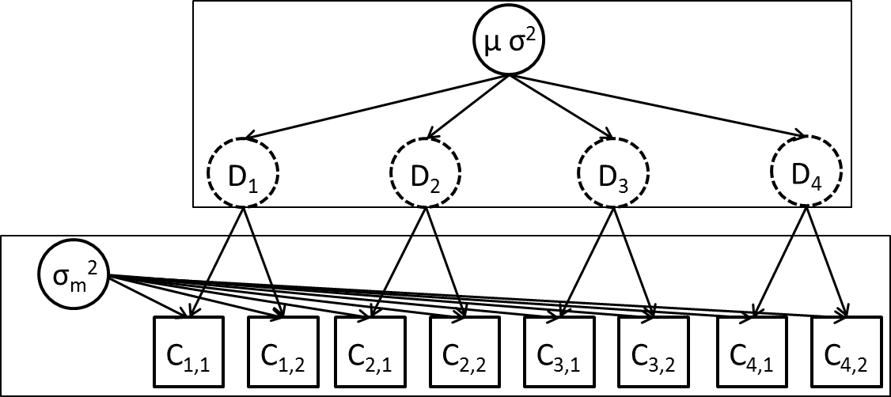
Example 1: Streams (sensu Pinherio and Bates, Chapter 1)
We are estimating fish density in streams.
We select six streams at random and determine the density at each stream three times.
The questions:
What is the density in a typical stream?
What is the variation in density among streams?
What is the variation in density estimates within a stream?
We would like to separately estimate measurement and between-site variability.

Slide 12
Example 1: Streams mixed effects model
We construct a mixed effects model as follows:
β is the mean density across the population,
b_{i} is a random variable representing the deviation from the population mean for stream i
ε_{i,j} is a random variable representing the deviation for observation j from mean density for stream i, i.e.

Slide 13
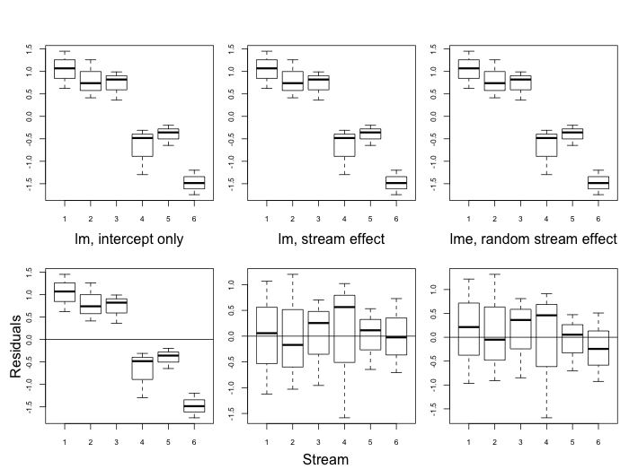
Fitting linear mixed effects models
These estimates are similar to the linear model with separate “stream effects” (but would not be if this was an unbalanced design).

Slide 14
Mixed Effects Modeling (some notes)
Residuals are assumed to be independent, normally distributed random variables with constant variance.
Random effects are assumed to be normally distributed.
This only works if the streams have been selected at random from the population of streams.
Mixed effects models are also called hierarchical models.
This model has 3 parameters (β, σ and σ_{b}).
There are ways to estimate the random effects. (we will often be interested in their values)

Slide 15
Estimation of mixed effects models
Maximum Likelihood Estimation (MLE)
is the vector of fixed effects parameters.
are the parameters controlling the distribution for the random effects.
We integrate across the random effects.
Effectively weight the probability of the observations given values for random effects by the probability of those values.
In the linear case, closed form solutions exist. For nonlinear models, we evaluate numerically or use approximations.

Slide 16
Random effects in RTMB
In MakeADFun, we add argument random
Names of parameters that are to be considered random effects
e.g. random=“stream”
Need to make sure we add the contribution to the likelihood function for the random effects in our function.

Slide 17
Streams model

Slide 18
Exercise 2: Growth estimation from lengths at release and recapture
Data set of bluegill recapture lengths
head(FSAdata::BluegillIL)
Laslett et al. (2002, CJFAS)
‘LEP’ method of estimating growth
Fit to Lengths at release/recapture instead of growth increment, time at liberty
Challenge: Growth models include Age, but these are not known!
Solution: Integrate across the age at release using random effects!

Slide 19
Parameters:
VBK Linf_mu
sigma_Linf
Sigma_obs
A_i (random effect)
Sigma_A
Mu_A
Data
Length 1
Length 2
dt
For each fish:
Mu_L1 (eq 3.5a)
Mu_L2 (eq 3.5b)
Sigma_L1 (eq 3.5c)
Sigma_L2 (eq 3.5d)
Cov_L1L2 (eq 3.5e)
Multivariate normal likelihood

Slide 20
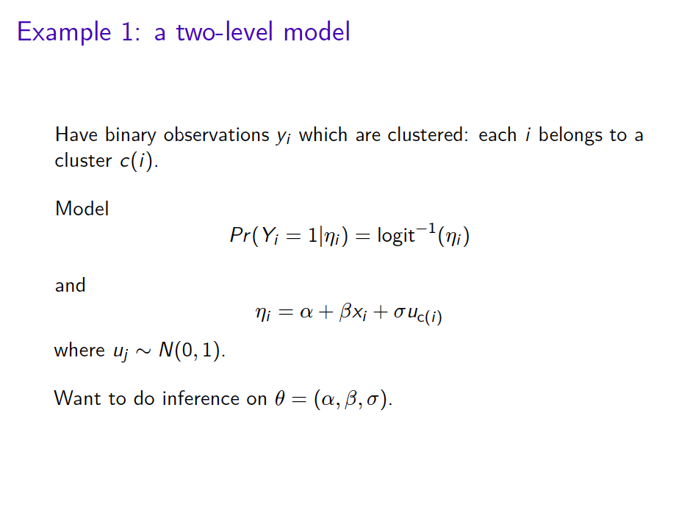

Slide 21
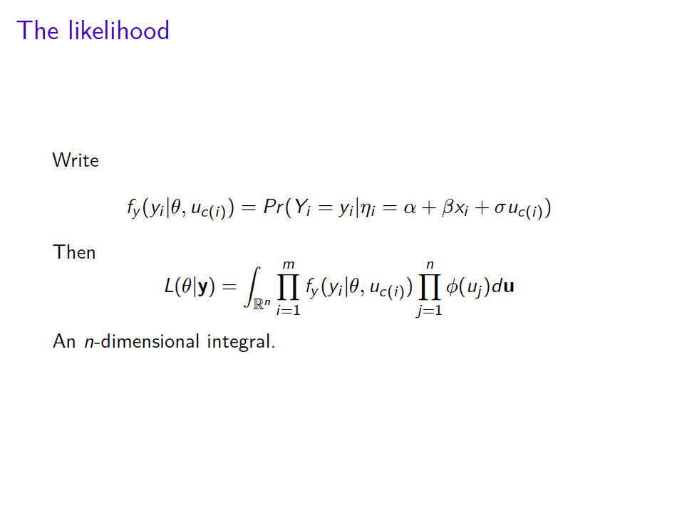

Slide 22
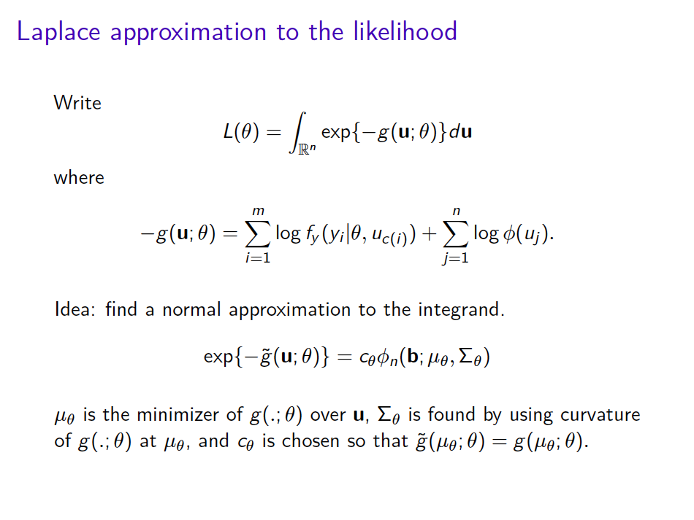

Slide 23
